Slide 1
Attribution Queries
April 23, 2019 to Jun 18, 2019
Bethany Compton

Slide 2
1. Get familiar with the company
1A: How many campaigns and sources does CoolTShirts use and how are they related? Be sure to explain the difference between utm_campaign and utm_source.
Answer:
Number of distinct campaigns: 8
Number of distinct sources: 6

Slide 3
1A: What is the difference between utm_campaign and UTM_source?
The source identifies which touchpoint sent the traffic (e.g. google, email, or facebook). The campaign identifies the specific ad or email blast. The goal of a campaign is to try to reach an audience and generate clicks and cash flow. If a user clicks on a campaign ad, the source can be used to identify which campaigns are successful and were not. For example, an ad with a source of Facebook can generate more clicks that an ad placed on an obscure source like “Obscureblog.com”. Both sources and campaigns are types of UTM parameters which capture information on how or where a user finds a website.

Slide 4
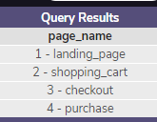
1B: What pages are on their website?
Answer: There are four pages.

Slide 5

2A: How many first touches is each campaign responsible for?
The last column depicts how many first touches each campaign had. There are other campaigns, but they did not have first touches.

Slide 6
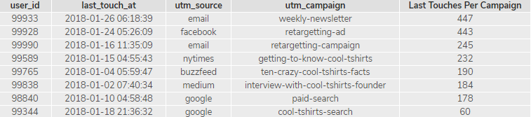
2B: How many last touches is each campaign responsible for?

Slide 7

2C:How many visitors make a purchase?

Slide 8
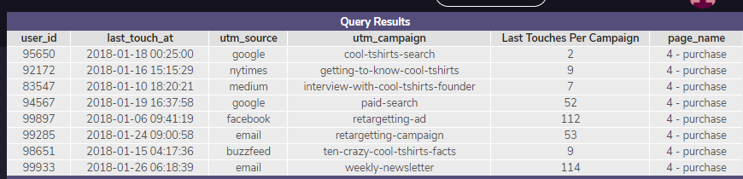
2D:How many last touches on the purchase page is each campaign responsible for?

Slide 9
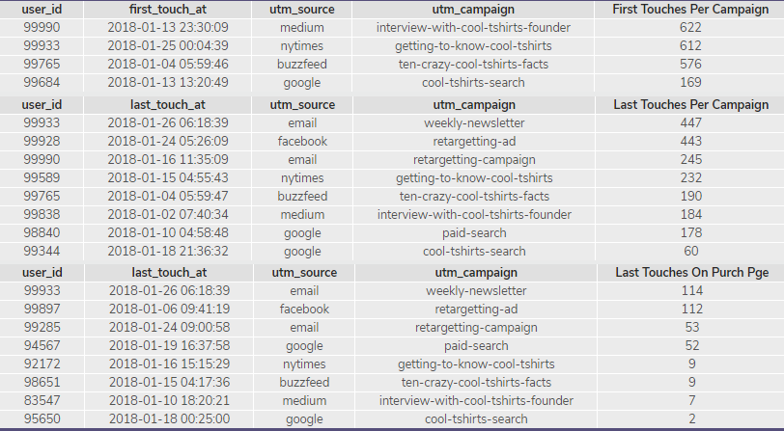
2E: What is the typical user journey?
The typical user journey started with the first touches for 4 different campaigns. However, even though many users were recorded there, those 4 campaigns didn’t typically have a last touch, except for the getting-to-know-cool-tshirts campaign.
The weekly newsletter campaign was the most successful, getting the most amount of users to have the last touch and to the purchase page.

Slide 10
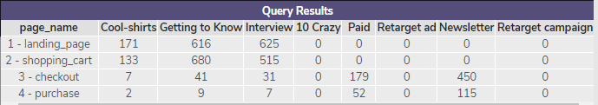
3: CoolTShirts can re-invest in 5 campaigns. Which should they pick and why?
CoolTShirts should invest in the following campaigns, beginning with which one drew the most people: The weekly-newsletter, The paid-search, getting-to-know-cool-tshirts, interview-with-cool-tshirts-founder, and then the cool-tshirts search.
CoolTShirts should select these campaigns because they drew in the most amount of revenue, while the remaining campaigns do not seem to have generated anything.

